Slide 1


COMBINING STATISTICAL AND MACHINE LEARNING MODELS FOR SPATIAL-TEMPORAL HOUSE PRICE DATA
Presentation by
Nehama Pearl Stern
Univeristy of Glasgow - 2024

Slide 2


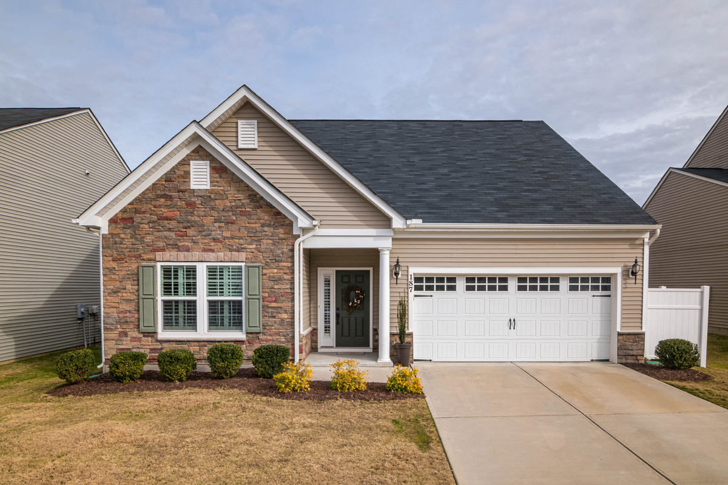


INTRODUCTION
The House Price Market
Predicting house prices is of use to any real estate investors, as it is important to know how much your property is likely to go up in value
Spatial-temporal moddeling
Spatial-temporal modelling combines the assumption that a time series as well as a spatial dependency exists within the data. Spatial-temporal modelling can be used in other areas such as epidemiology and environmental science
01
Notes:
What makes this model so complexed is that we are using the elements of the spatial dependency, time series withing the data, using statistical models such as a Bayesian statistics and combining it with machine modeling. This aims to bring out the best of all aspects that can be analyzed.

Slide 3

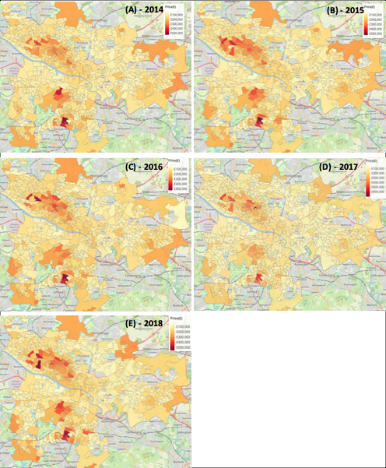
DESCRIPTION OF DATA
Scottish government’s official statistics publication.
Average of each data zones are used.
These data zones were established in the 2011 census and divide Scotland into 6976 zones.
The response variable is the median property price for each data zone, from the years 2014 to 2018.
As the covariates are not fully available across the years, covariates are selected for a single year, mostly data available close to the year 2016.
Economic indicators
Accessibility of the zone
02
Health indicators
Description of data zone
Geographical outline

Slide 4
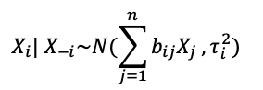
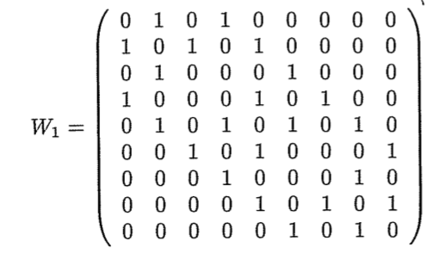
CONDITIONAL AUTOREGRESSIVE (CAR) MODELS
Values at a specific location are conditional to its neighboring values
A Markov chain is a sequence of random variables given the property that each future state is dependent on the present state only.
In a CAR model, A binary matrix, w is used to represent the neighborhood structure.
CAR models are an example of a Markov random field. The full conditional distribution:
B is a nxn matrix, containing the regression coefficients with a specific variance for each location. xi is conditional on the sum of the weighted values of its neighbors. The weight depends on the level of spatial dependency of the neighbors on the location.
03

Slide 5
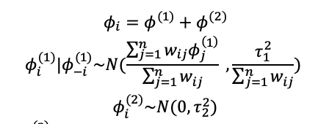
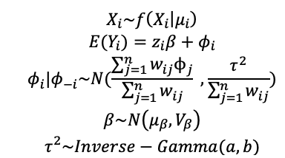
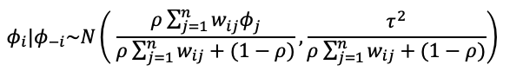
CONDITIONAL AUTOREGRESSIVE (CAR) MODELS CONT’
Intrinsic conditional autoregressive (ICAR) model assumes complete spatial correlation between regions and should therefore be used in scenarios where strong spatial correlation is assumed.
Convolution or BYM CAR model, adds a set of random effects
ICAR priors usually cannot be used for the data (likelihood) so are therefore used to model the random effects instead.
In a Leroux model, the conditional distribution captures both the structured and unstructured spatial random effects into one parameter
p represents the amount of spatial autocorrelation.
A general form of a hierarchical ICAR model,
following a Bayesian structure:
04

Slide 6
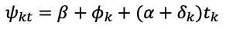
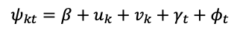
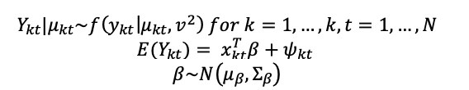
SPATIAL-TEMPORAL CAR MODELS
K non overlapping aerial locations
Ways to define ψ_kt :
Bernardinelli et al. (1995)
Leonhard Knorr-Held, (2000)
expanded;
N time points
The response, Y will be aranage in a K x N matrix
ψ_kt represents the spatial-temporal random effects
05

Slide 7
SAMPLING METHODS
Markov chain Monte Carlo (MCMC)
Integrated Nested Laplace Approximations (INLA)
Markov chains are constructed on the variable. The transition probability is constructed so that the Markov chain converges to the required stationary distribution
Faster than MCMC
INLA approximates the posterior distribution for each univariate parameter by a Laplace distribution rather than drawing random samples from it.
06

Slide 8
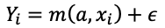
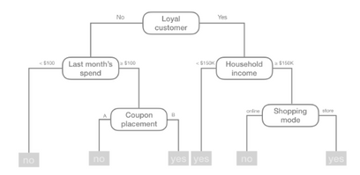
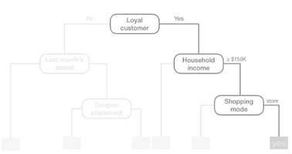
RANDOM FOREST (RF)
Decision trees
Random forest
Divides the training data into subgroups with a similar response variable. The subgroups are used to create decision nodes for the tree which are formed by creating simple questions regarding the features of the data. After all the partitioning has been completed, the model predicts the output based on the observations in that subgroup
Combine multiple decision trees. The prediction of each trees are aggregated to a final decision.
Yi is the response variable for each observation, m is unknown random forest function which links the individual trees, a is the parameter, estimated by variables x with e being an error term.
07

Slide 9
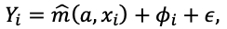
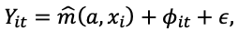
CAR-FOREST
CAR-Forest
Spatial-temporal CAR-Forest
Including spatial correlation, the model can be extended to add a parameter which encompasses the spatial correlation.
In the first stage, random forest is used to estimate the non-linear effects of the variables.
The second stage involves estimating the spatial autocorrelation parameter, using a Bayesian CAR model. The results from the RF are used as fixed offsets in the CAR model.
Novel approach to modelling spatial-temporal data.
Extending the CAR-RF, the spatial correlation parameter can account for both spatial, temporal correlation.
The steps for the algorithm are as follows:
The random effects are set to zero
A decorrelated target variable is set to be the difference between the true values and random effects.
A random forest model is set to the data using the variables and target variables which estimates the effects of the variables. The model is used to make predictions.
These predictions are used as fixed offsets in the CAR model which now too makes predictions based on the spatial and temporal dependencies. This crated a new estimate of the random effects.
08

Slide 10
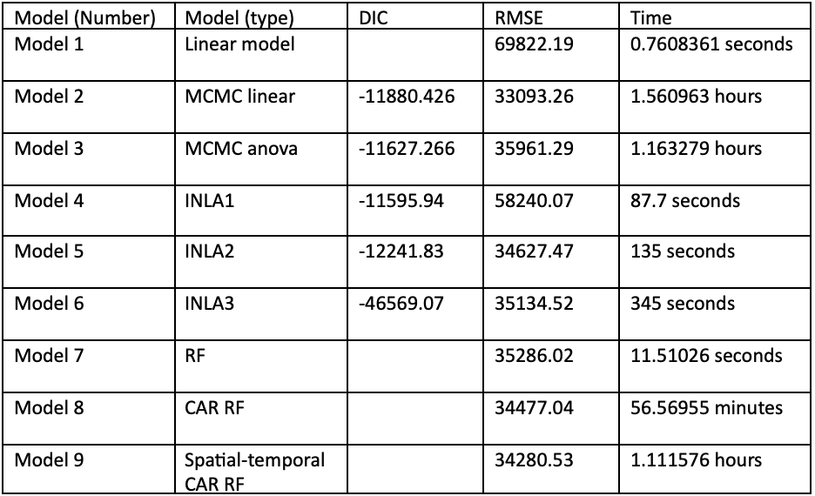
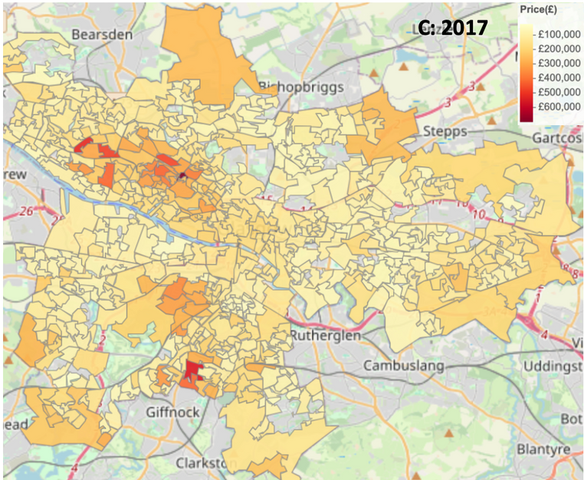
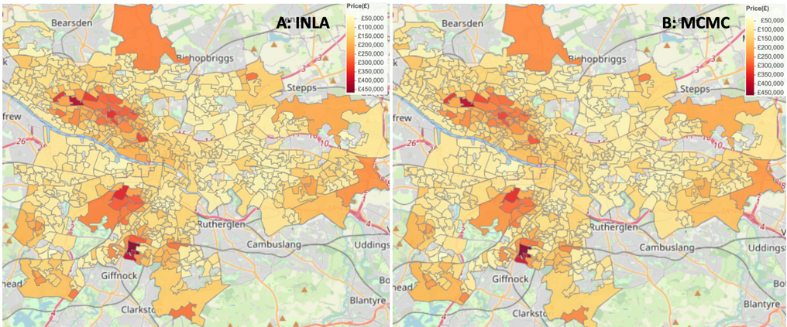
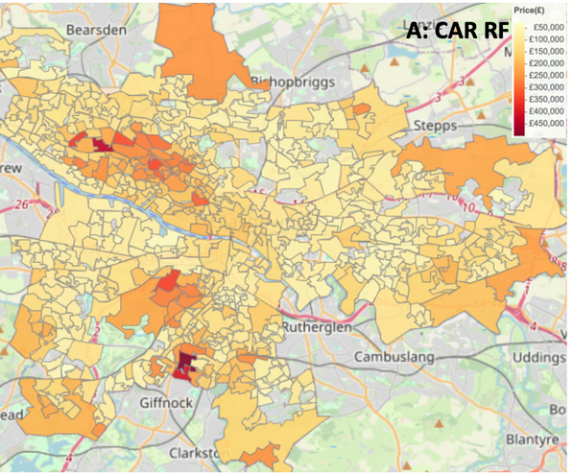
RESULT
Actual values
Model 2
Model 6
Model 9
09

Slide 11
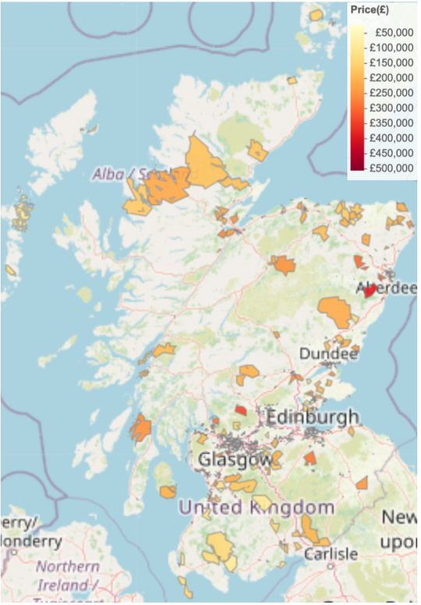
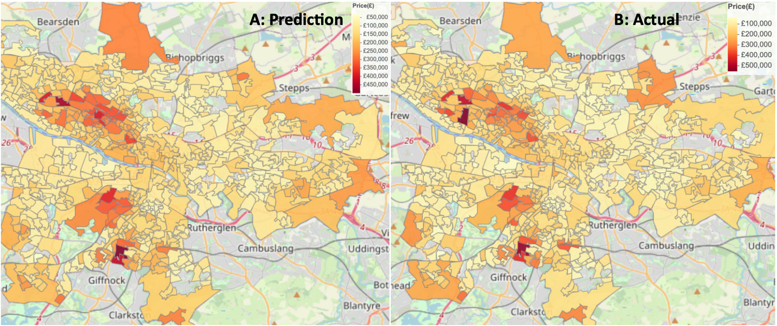
RESULT
Data zones where the error was less than £5,000
2018 predictions:
DIC:-17343.689
RMSE: £32379.9
10

Slide 12
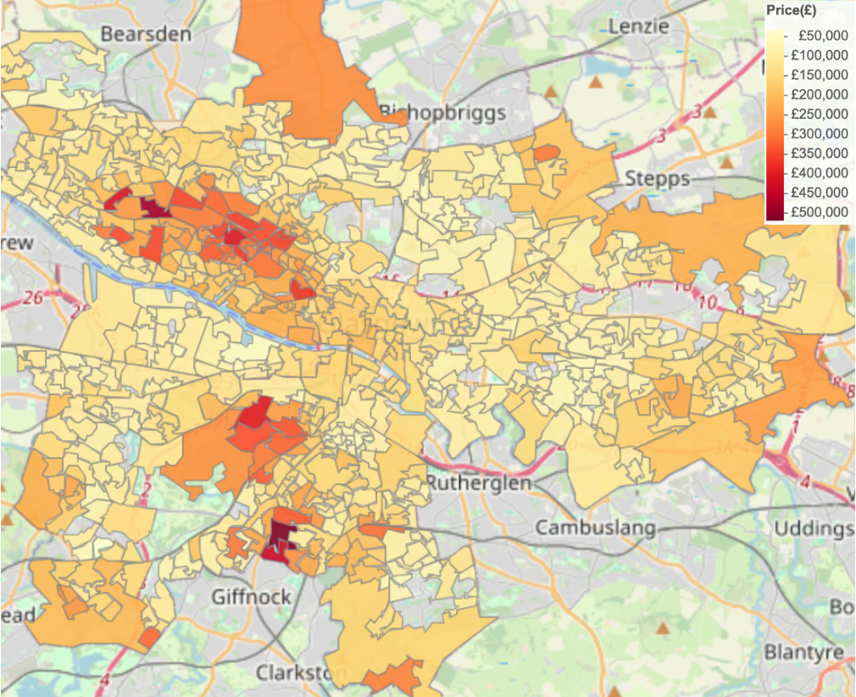
CONCLUSIONS
2019 predictions:
DIC: - 21703.430
Assumptions and limitations:
Covaries stationary throughout time series
Anomaly in 2017
Variable reduction
Increase length of time series
Imputation of missing values
Other deep learning techniques
Position of covariates in CAR-RF
11

